Slide 1
Automatically Generate Description for Image with Deep Learning
Guang Yang
Juiche Tsai
Shipeng Guo

Slide 2
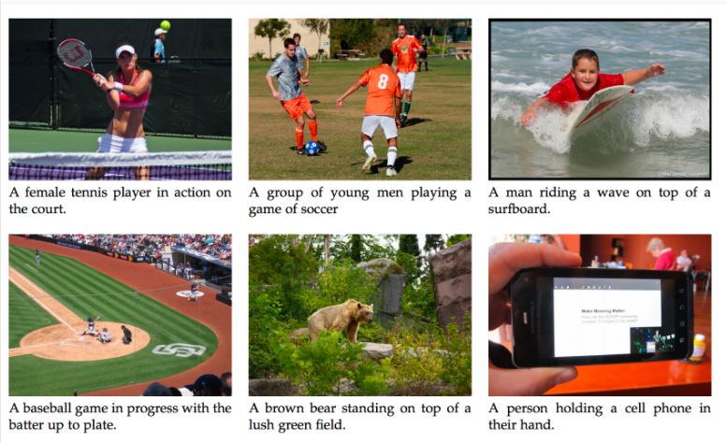
What is that?
Input an image to the machine, and the machine will output a sentence of text to describe the picture .

Slide 3
Application
Short term: Can be a huge help for blind people. They can know what is in front of them or what is around them.
Long term: Applying this into videos. Let the machine explain what happen in the videos. Audiences also can decide whether they want to watch the video after seeing the decription.

Slide 4
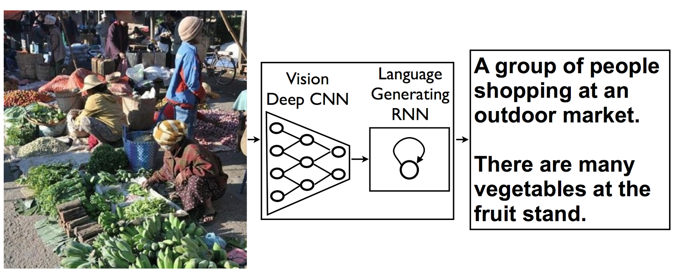
Basic structure

Slide 5
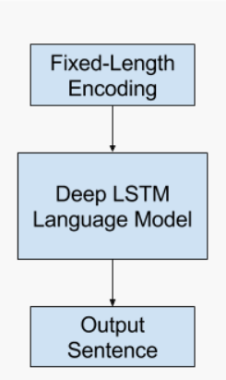
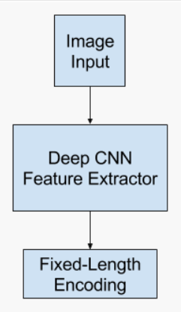
Feature Language extractor model

Slide 6
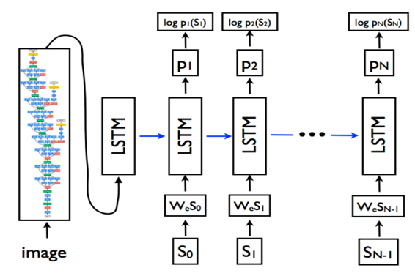
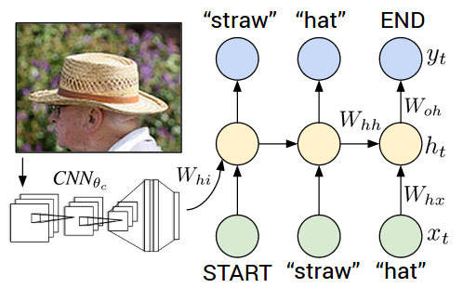
Basic structure

Slide 7
Model details

Slide 8
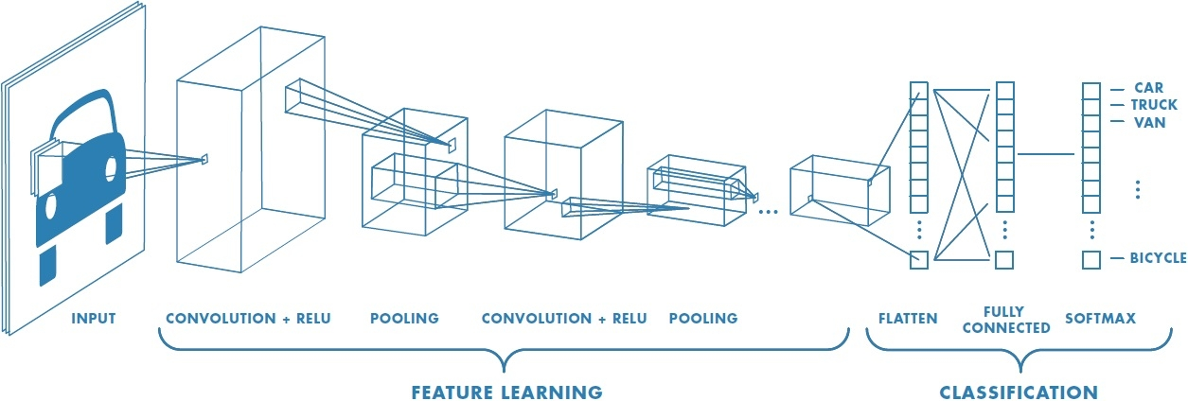
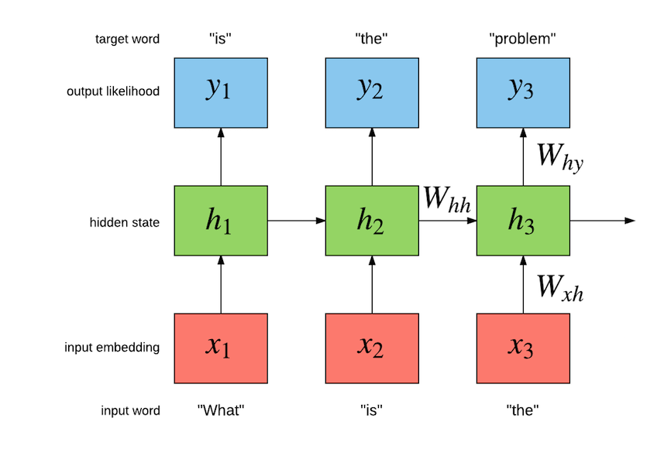
Model details
Convolutional neural network to process image
Recurrent neural network to generate text

Slide 9
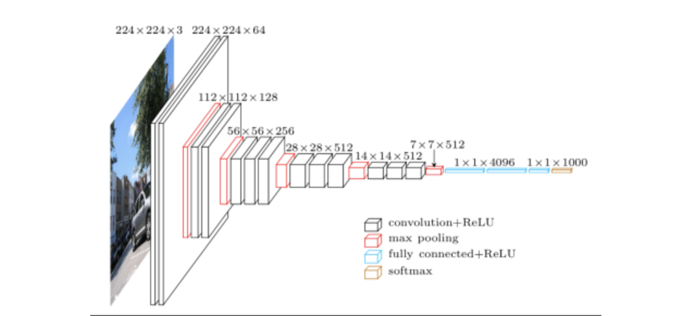
CNN part– VGG network
The overall architecture of VGG16

Slide 10

RNN part --- LSTM
LSTMs also have this chain like structure, but the repeating module has a different structure. Instead of having a single neural network layer, there are four, interacting in a very special way.

Slide 11
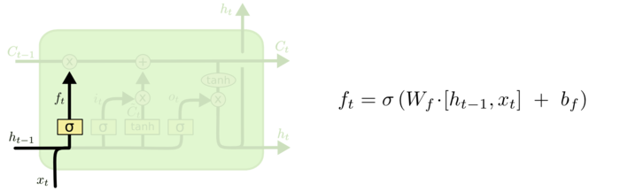
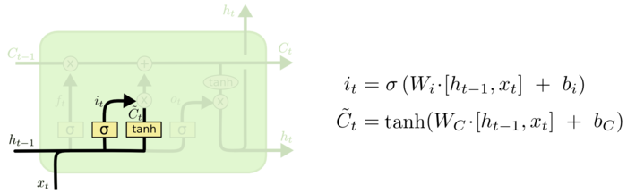
Forget gate || input gate

Slide 12
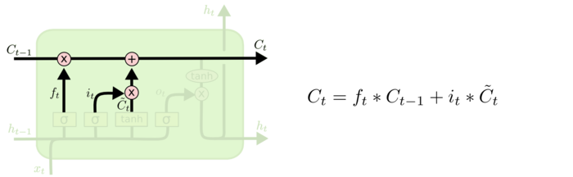
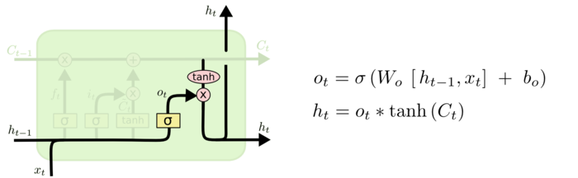
Update cell state || output gate

Slide 13
RNN part
The input of the first unit of the caption generator(RNN PART) would be the output of CNN part and a #START signal
The image representation output by CNN is only input once to inform the LSTM about the image contents.

Slide 14
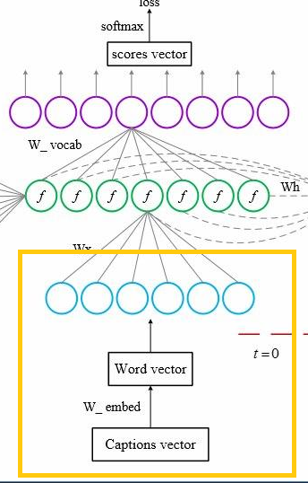
Before input --- word embedding
we represent each word as a one-hot vector St of dimension equal to the size of the dictionary.
Then we transform the one-hot vector to a dense word representation.

Slide 15
Advantages
Firstly, it will significantly lower the number of parameters in the networks because the dense word vector is much smaller than the one-hot word vector.
Secondly, the dense word embedding encodes the semantic meanings of the words. The semantically relevant words can be found closer to each other by calculating the Euclidean distance between two dense word vectors in embedding layers, whereas the one-hot vectors representation lose this information because they are all perpendicular to each other.

Slide 16
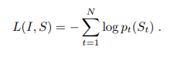
TRAINING
Loss is minimized w.r.t. all the parameters of the LSTM, the top layer of the image embedder CNN and word embeddings.
Step 1 : using pre-trained network inception v3 and make the parameters fixed, only train the model of caption generator(LSTM)
Step 2: fine-tuning CNN parameters, train CNN & LSTM together

Slide 17
Inference
Sampling : sample the first word according to p1, then provide the corresponding embedding as input and sample p2, continuing like this until we sample the special end-of-sentence token or some maximum length.
Beam Search: iteratively consider the set of the k best sentences up to time t as candidates to generate sentences of size t + 1, and keep only the resulting best k of them. This better approximates S = arg maxS0 p(S 0 |I).

Slide 18
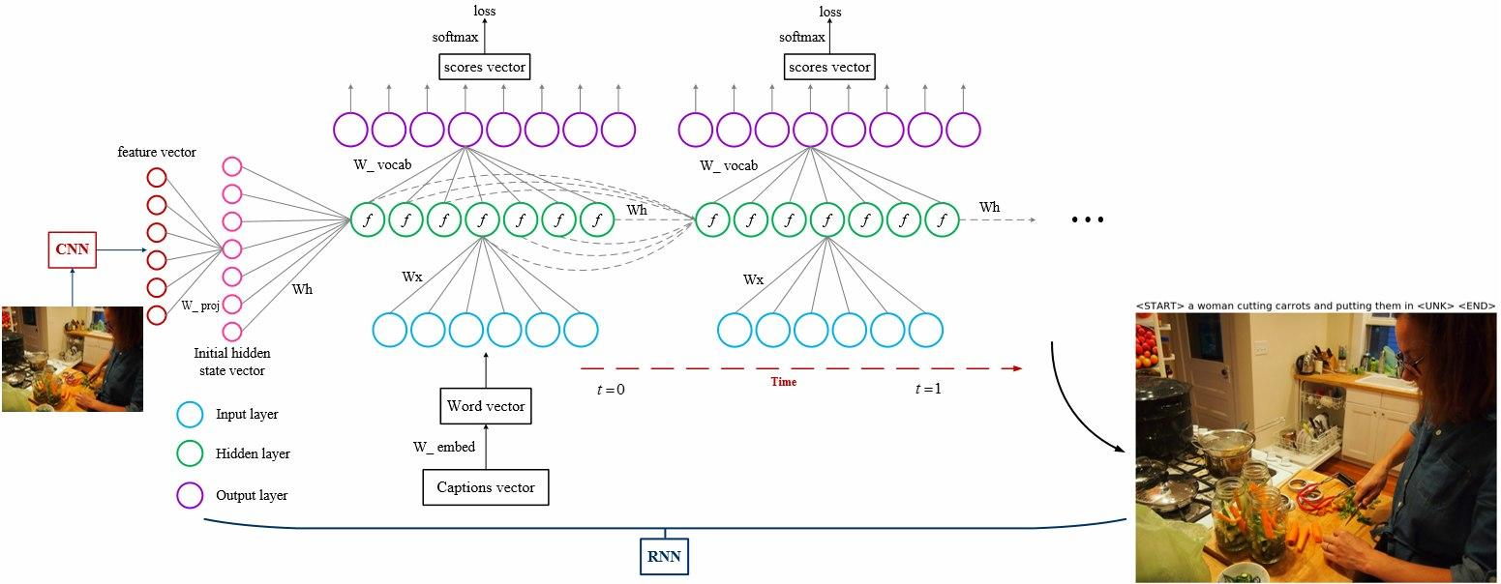
Expected result example

Slide 19
Experiment
After fine-tuning, here we can train our
model with enough image sets.

Slide 20
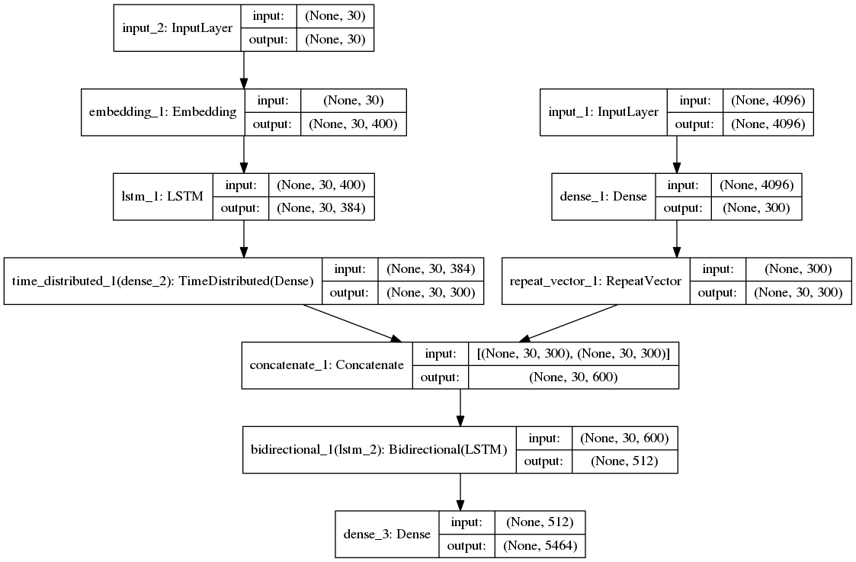
Final architecture in our project
After modifying our models many times, we determine use following to concretely show our architecture.

Slide 21
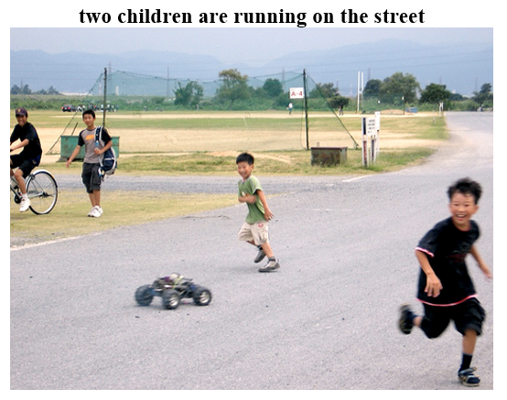
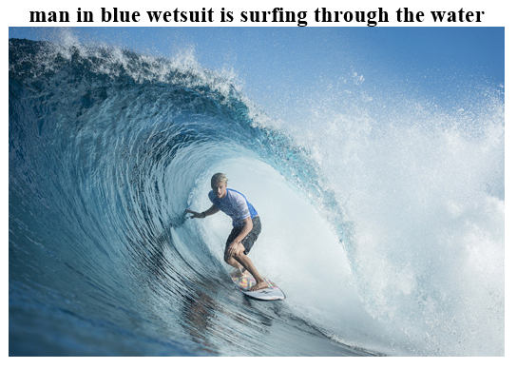
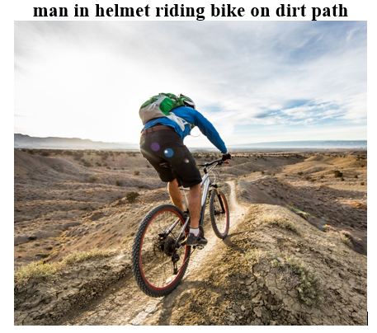
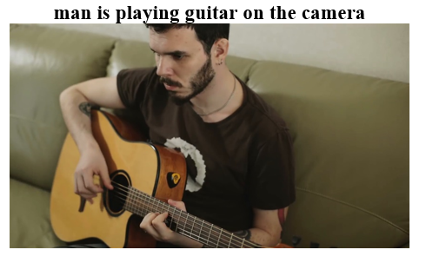
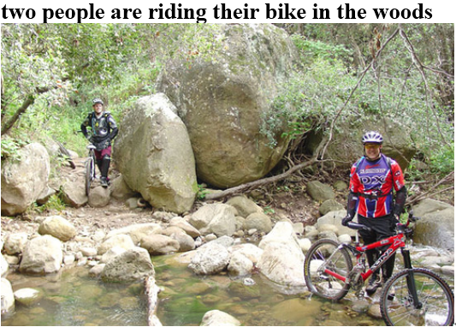
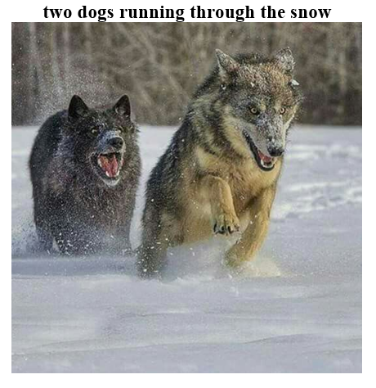
Exciting results

